Slide 1

Games Research & Development Block 03 – Week 03

Slide 2

THIS WEEK
Video / Demo
One-on-One Meetings

Slide 3
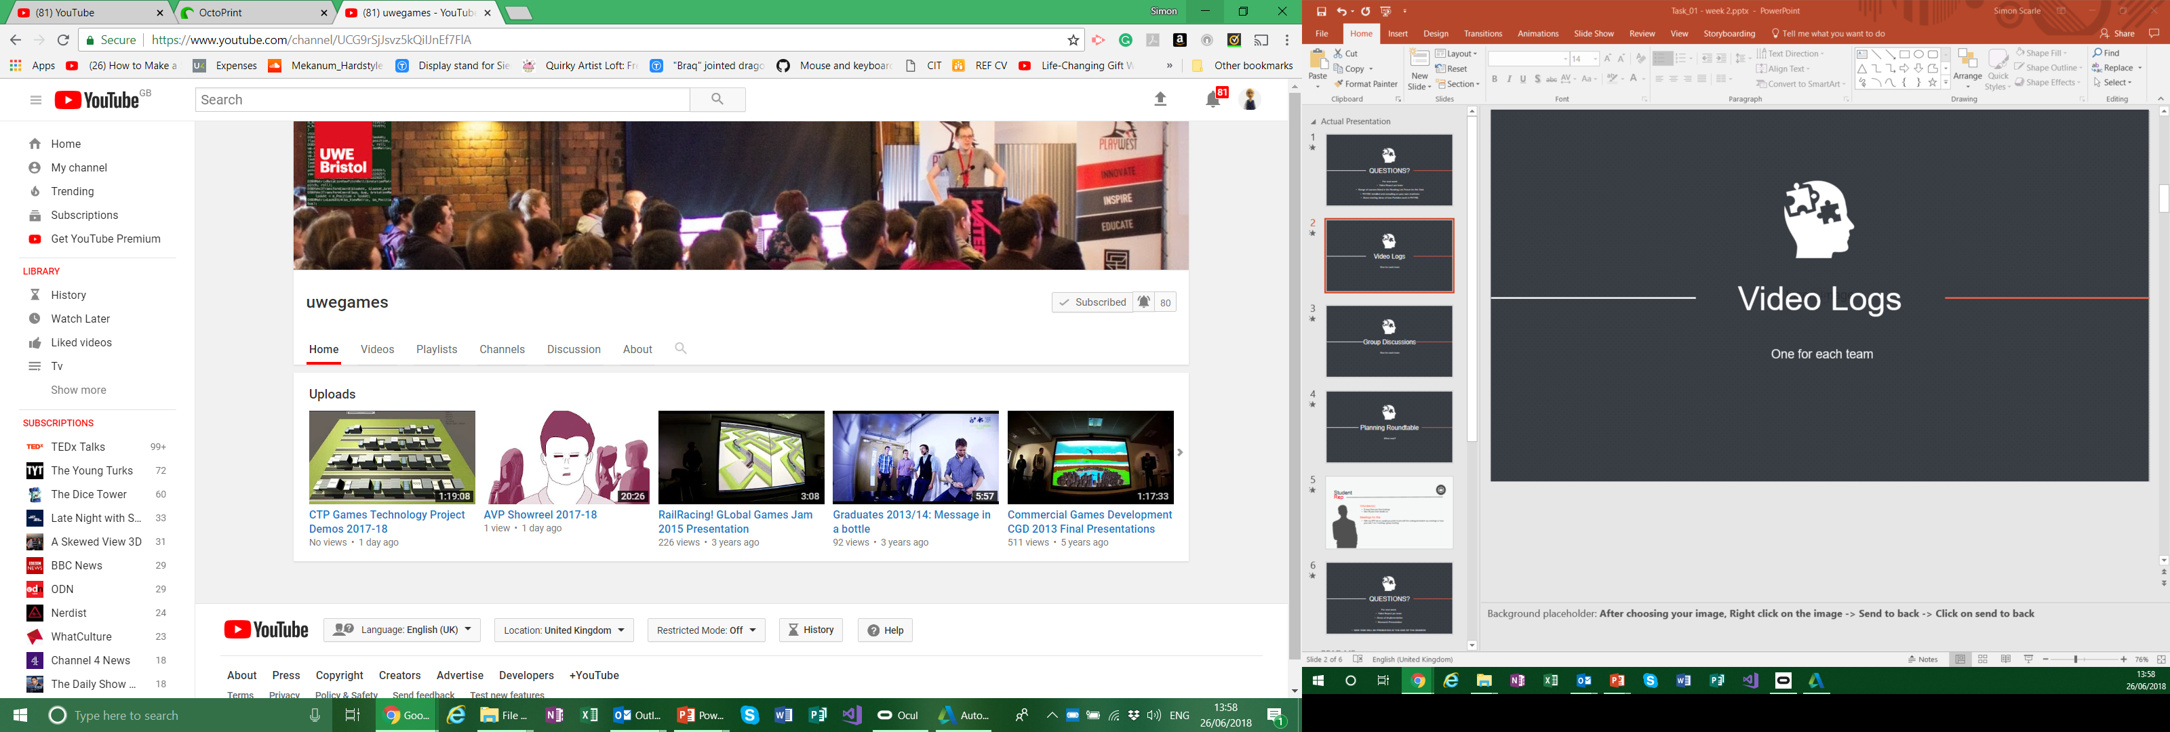
Video Logs
Place your screenshot here
Unlisted YouTube video.
I’ll add them to this years play list later!
If you think you made something pretty enough
+ TWEET + @UWEGamesMSc

Slide 4
DEMOS!
Place your screenshot here

Slide 5

One-On-One Meetings

Slide 6
Any questions?

